Slide 1
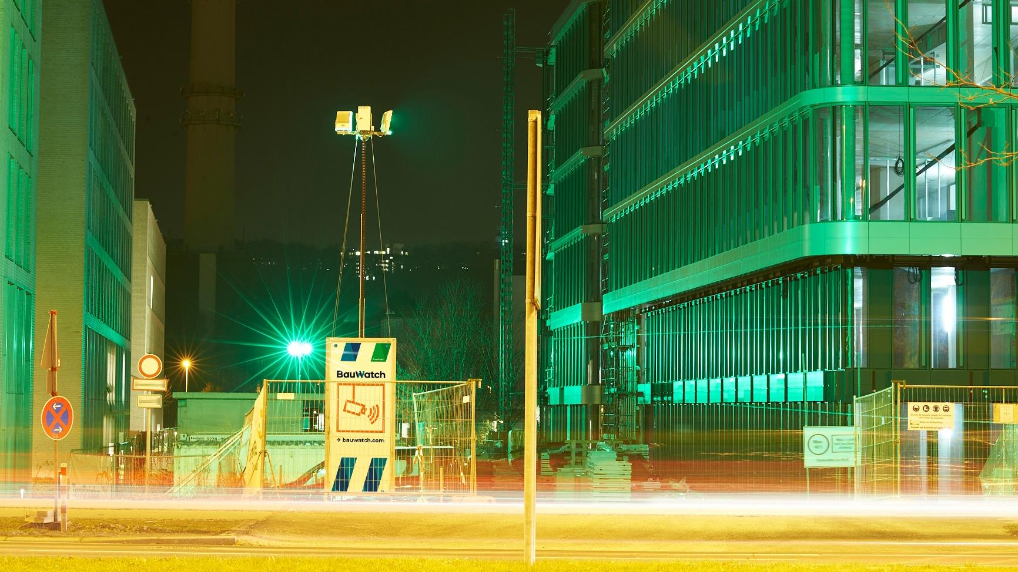
Code of Ethics
Business Partner

Slide 2

Welcome
Welcome to BauWatch’s Code of Ethics!
As a market leader and a high-growth company expanding into new markets, we are committed to maintaining and setting the highest ethical standards.
At BauWatch we believe that success goes hand in hand with responsible, transparent, and ethical business practices. We embrace the principle of creating economic value while also enhancing social values. We take responsibility, not only focused on good economic decisions, but also on how they impact the world today and for future generations. With this in mind, we present you our Code of Ethics, which serves as a guiding document for all our employees, partners, and stakeholders, outlining our core principles and values.
The Code sets clear expectations for behavior, placing a strong emphasis on integrity, trust, and respect. It provides essential guidance on fairness, honestly, compliance, conflict of interests, confidentiality, diversity, inclusion, and the importance of safe work environment.
As we venture into new markets, we remain adaptable while maintaining our unwavering commitment to ethical conduct, we encourage everyone to familiarize themselves with the Code and integrate its principles into their daily activities. By doing so, we cultivate a culture of integrity, accountability, and professionalism.
Thank you for embracing our Code of Ethics, as we work together to build a company that excels in the temporary surveillance industry while upholding our strong ethical principles.
Al Ghelani.

Slide 3
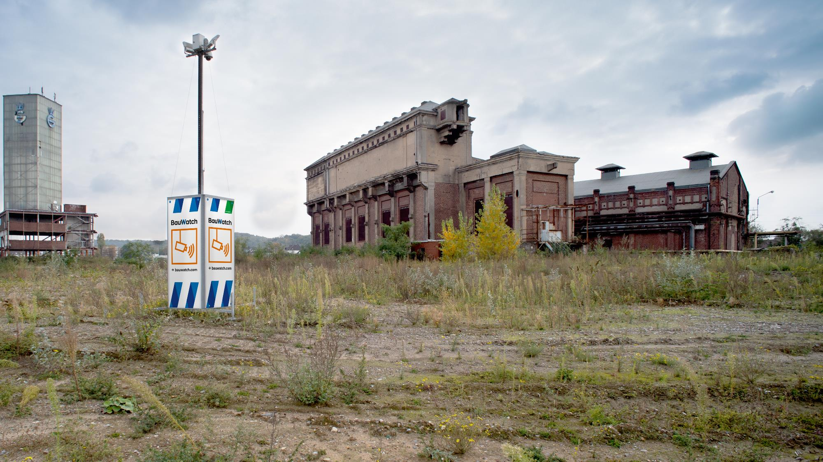
Compliance with the law
Our business partners comply with the legal requirements of each applicable jurisdiction.

Slide 4
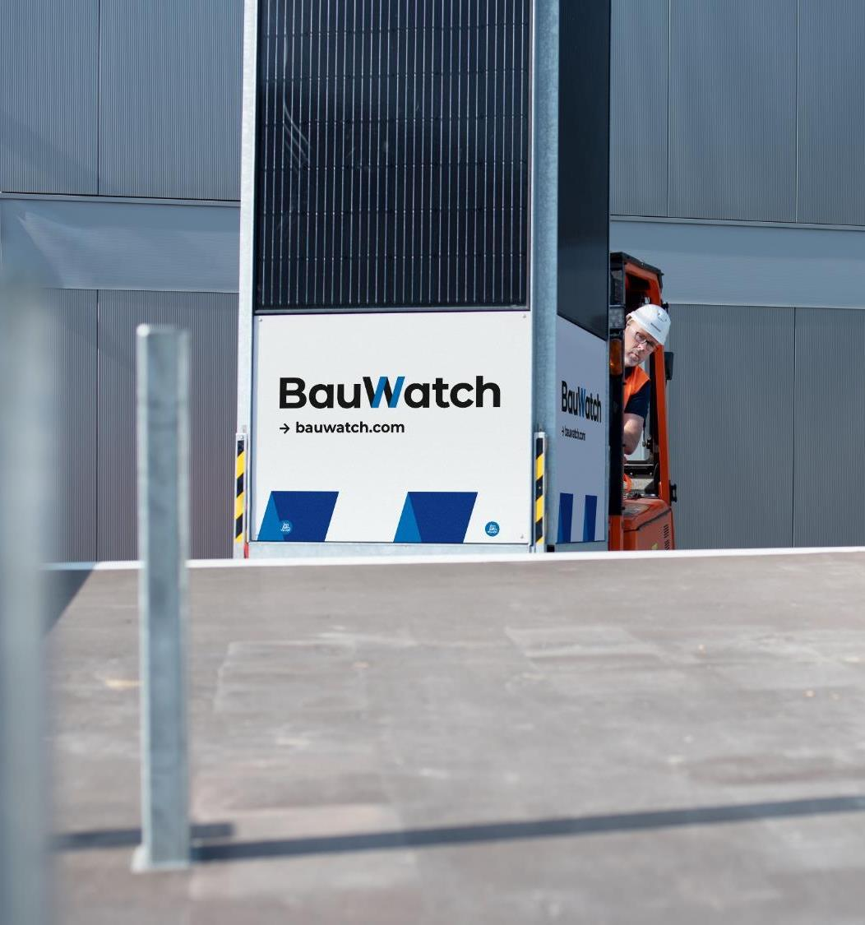
Human rights and working conditions
BauWatch does not tolerate human rights violations. Our business partners undertake to comply with national and international regulations on the protection of human rights.
Child labor is prohibited. Business partners are requested not to permit the employment of children either in their own operations or those of their business partners.
Employment relationships arise exclusively on a voluntary basis and can be terminated in compliance with agreed termination periods. Forced labor and any form of modern slavery and human trafficking are not permitted.
Our business partners create fair and secure jobs. They do not tolerate discrimination based on gender, age, ethnic origin, nationality, social status, political opinion, or sexual orientation and promote diversity. The work environment is free from harassment and unlawful practices or discrimination.

Slide 5
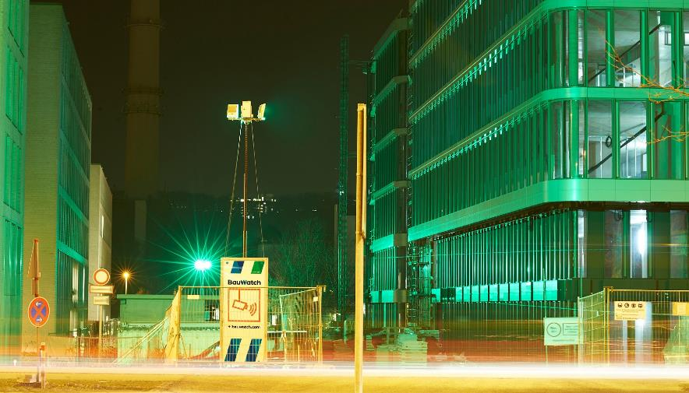
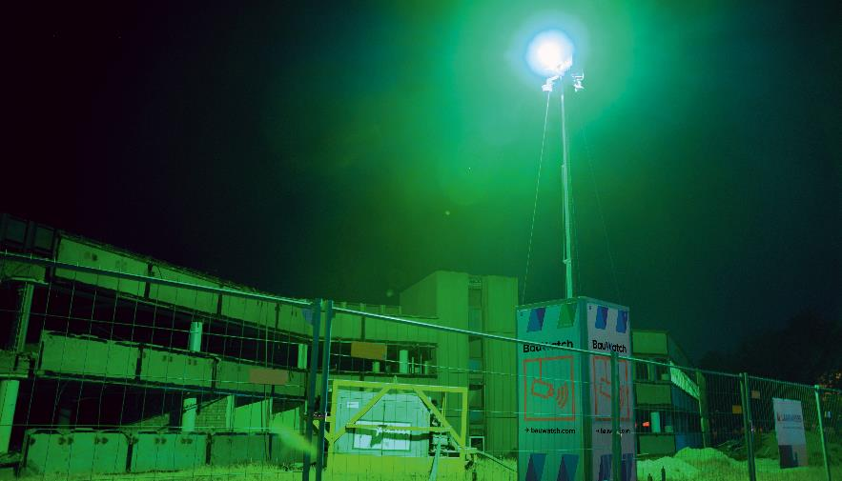
Freedom of expression and association
No conflicts of interest
          Our business partners are committed to protecting freedom of expression and personal rights and support the right to organize and collective bargaining in accordance with applicable laws.
Business decisions are made exclusively on the basis of proper considerations. Personal interests, especially of a financial nature, must not play a role. Our business partners therefore undertake to prevent conflicts of interest.

Slide 6
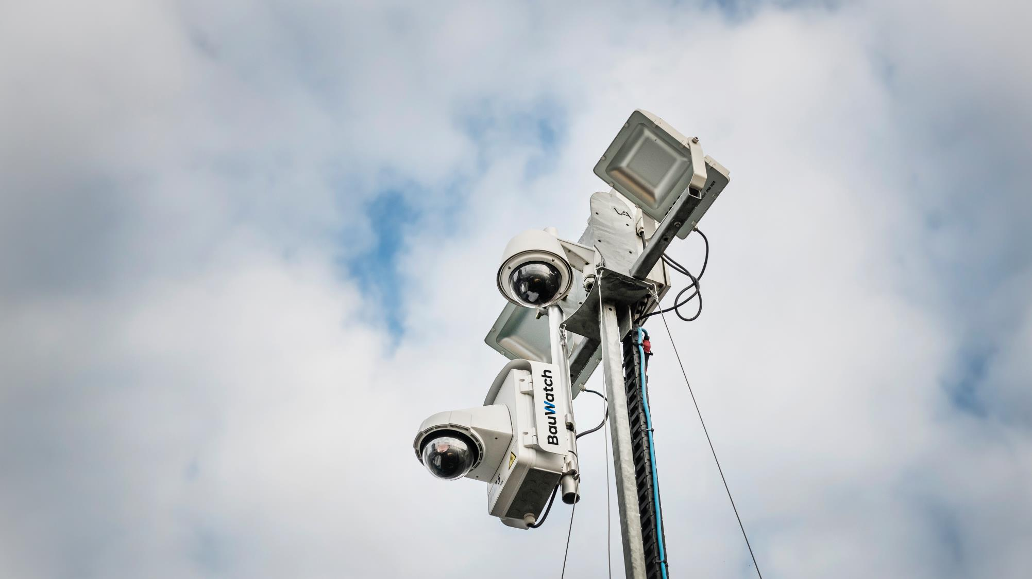
No bribery & corruption
          BauWatch does not tolerate any form of bribery or corruption. At BauWatch, business decisions are based on objective criteria such as the reliability and integrity of a business partner, the price and the quality of products or services. Decisions must never be influenced by the prospect of granting or receiving personal benefits to public officials or private business partners.
          Our business partners therefore undertake not to offer, request and/or accept gifts, payments, services, or invitations that could improperly influence a business relationship.

Slide 7





Fair competition
Our business partners comply with all relevant competition law requirements. In particular, they do not engage in collusion with competitors or conduct that unlawfully prevents or restricts competition.
Sanctions
Our business partners ensure compliance with all applicable laws governing the import and export of goods, services, and information, as well as applicable embargoes and sanctions.
Money laundering and terrorist financing
Our business partners comply with all laws prohibiting money laundering or the financing of illegal or illicit purposes. They take appropriate measures in their companies to prevent money laundering and terrorist financing in their companies.
Data privacy and information security
Our business partners must protect the personal data of their employees, business partners and customers. They must also ensure that the use of personal data – as well as the collection, recording, storage and deletion of such data – is always carried out in compliance with applicable laws and regulations. Confidential information of all own employees as well as of business partners will not be disclosed to third parties without authorization and will be protected at all times, by appropriate information security measures.

Slide 8
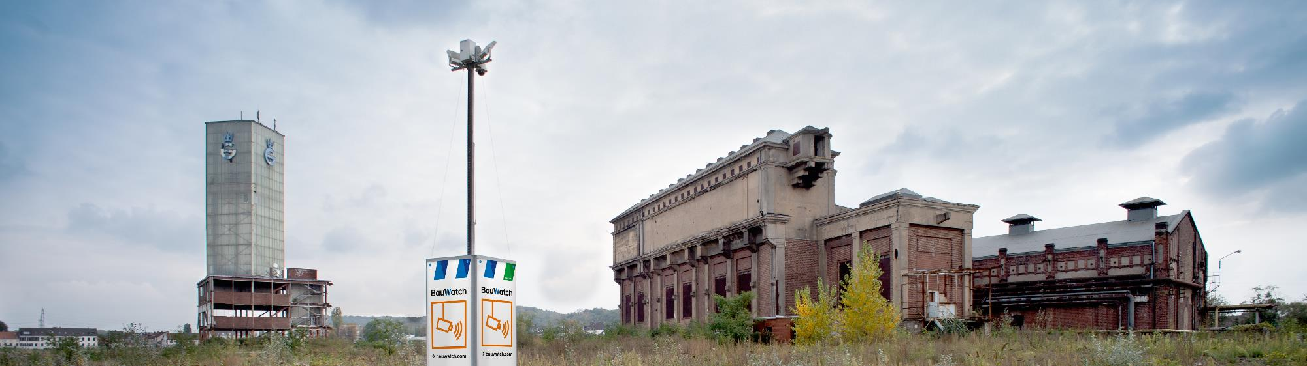

      Safety and health in the workplace
      Our business partners provide their employees with a safe and healthy working environment and regularly identify potential safety risks in accordance with legal requirements. This means: Preventing accidents, establishing appropriate occupational health and safety management for this purpose, i.e. identifying, assessing and reducing actual and potential accident and health risks, recording and investigating incidents, training and instructing employees in a form they can understand, providing appropriate work tools and protective equipment, and taking appropriate emergency care and response measures.
      Responsibility to the environment and communities
      Responsible treatment of the environment and natural resources is a matter of course for BauWatch. We try to ensure that our activities have as little impact on the environment as possible and we promote environmental awareness among our employees. We also have this expectation of our business partners.

