Slide 1
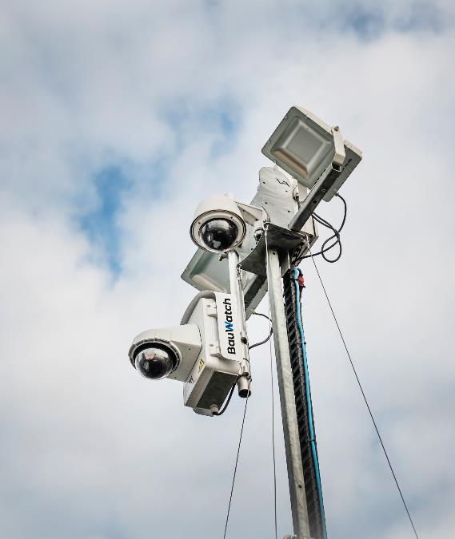
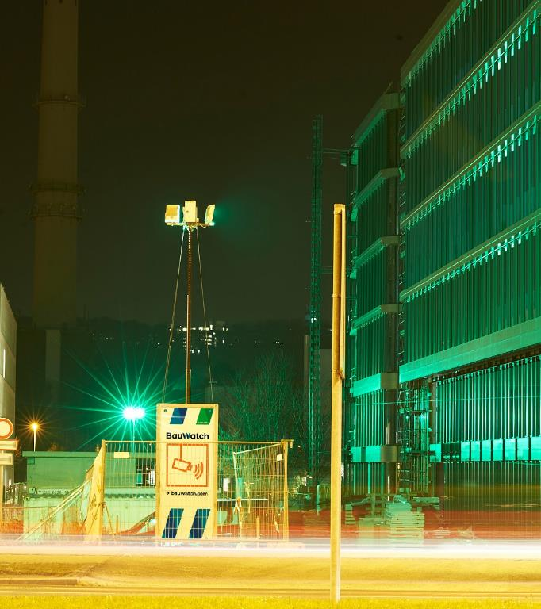
How to access SpeakUp
Country Phone Instruction Webservice URL Access code
AUSTRIA 0800-295175 www.speakupfeedback.eu/web/bauwatch/at 53878
BELGIUM 0800-71365 www.speakupfeedback.eu/web/bauwatch/be 53878
FRANCE 0800-908810 www.speakupfeedback.eu/web/bauwatch/fr 53878
GERMANY 0800-1801733 www.speakupfeedback.eu/web/bauwatch/de 53878
ITALY 800-787639 www.speakupfeedback.eu/web/bauwatch/it 53878
NETHERLANDS 0800 0222931 www.speakupfeedback.eu/web/bauwatch/nl 53878
POLAND 008004411739 www.speakupfeedback.eu/web/bauwatch/pl 53878
SPAIN 900-973174 www.speakupfeedback.eu/web/bauwatch/es 53878
UK 0800-1693502 www.speakupfeedback.eu/web/bauwatch/gb 53878
You can use either the phone line or the URL.
Please find the full Whistleblowing Policy and Manuel here.

